Slide 1

SOEE1475 Statistics and Data Analysis
Lecture 5: Spatial statistics
Graeme T. Lloyd

Slide 2

Today
Spatial patterns of point distributions
Chi-square test
Nearest neighbour distances

Slide 3
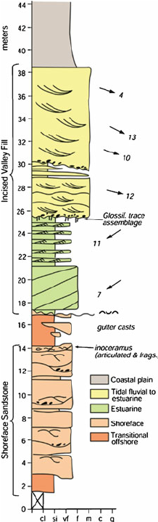
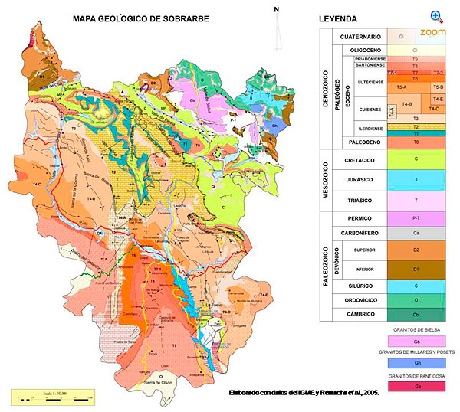
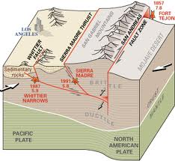
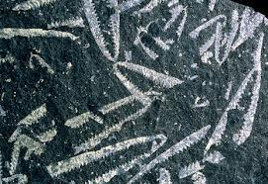
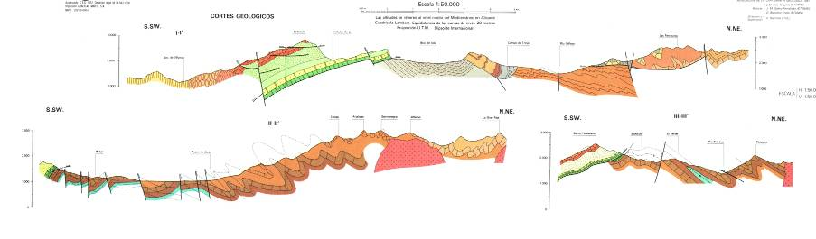
Spatial data in geology
1D
2D
3D

Slide 4
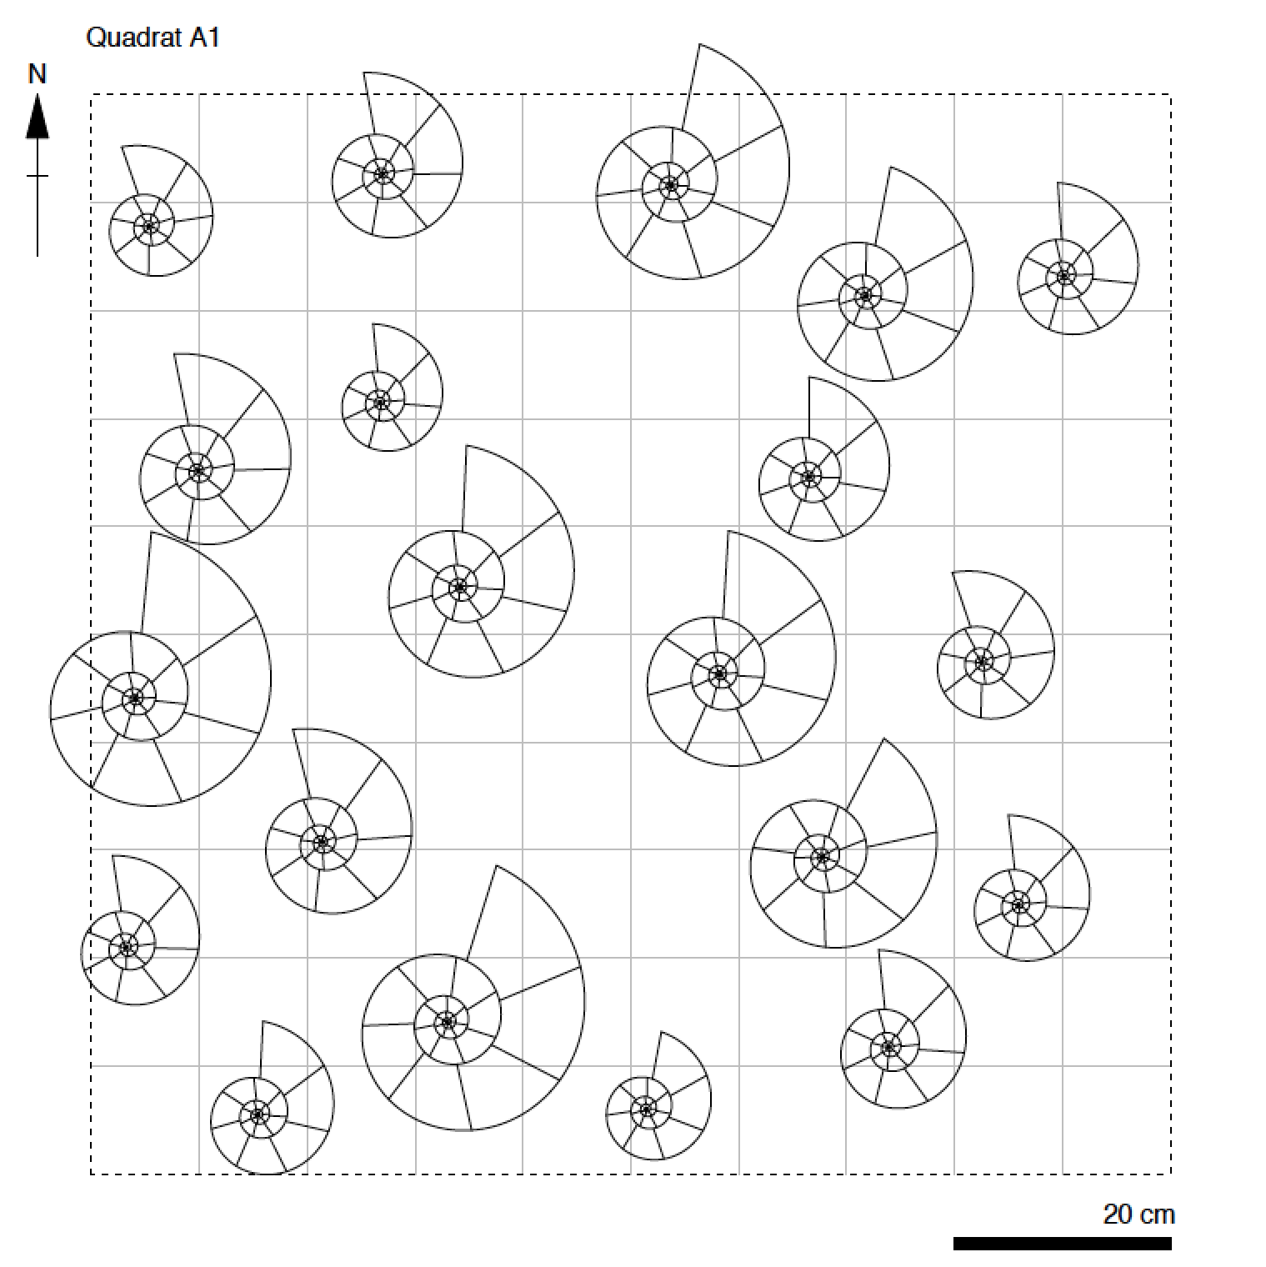
Point distributions

Slide 5
Point distributions
Isotropic
Regular
Uniform
Random
Clustered
Anisotropic
Homogeneity
Heterogeneity
Anisotropic

Slide 6
Point distributions

Slide 7
Point distributions
2
1
1
2
1
4
0
3
1
2
2
1
2
1
2
0

Slide 8
Point distributions
Regular
Uniform
Random
Clustered

Slide 9
Exercise – part I

Slide 10
Exercise – part I
Regular
Uniform
Random
Clustered

Slide 11
Exercise – part I
Q1
Q2
Q1 =
Q2 =
Q3 =
Q4 =
Q3
Q4

Slide 12
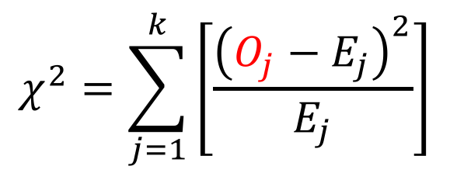
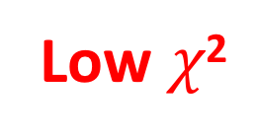
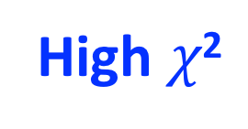
The Chi-squared test – testing for uniform
Low $χ$²
High $χ$²
$$χ^{2}=\sum_{j=1}^{k}{\left[\frac{{\left(O_{j}−E_{j}\right)}^{2}}{E_{j}}\right]}$$

Slide 13
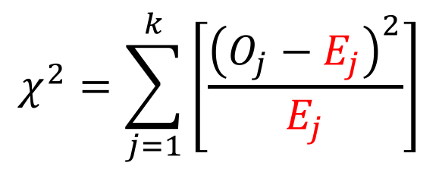
The Chi-squared test – testing for uniform
Low $χ$²
High $χ$²
$$χ^{2}=\sum_{j=1}^{k}{\left[\frac{{\left(O_{j}−E_{j}\right)}^{2}}{E_{j}}\right]}$$

Slide 14
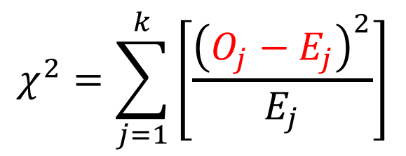
The Chi-squared test – testing for uniform
Low $χ$²
High $χ$²
$$χ^{2}=\sum_{j=1}^{k}{\left[\frac{{\left(O_{j}−E_{j}\right)}^{2}}{E_{j}}\right]}$$

Slide 15
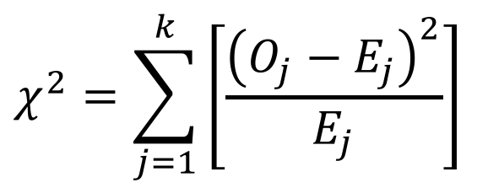
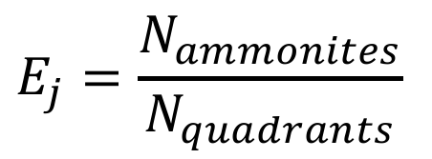
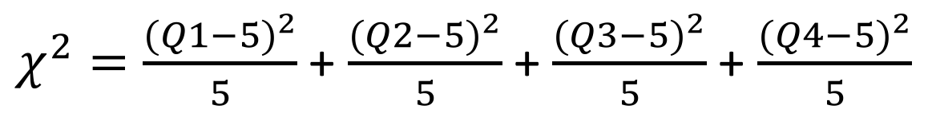
Exercise – part II
$$χ^{2}=\sum_{j=1}^{k}{\left[\frac{{\left(O_{j}−E_{j}\right)}^{2}}{E_{j}}\right]}$$
$$E_{j}=\frac{N_{ammonites}}{N_{quadrants}}$$
$χ^{2}=\frac{{(Q1−5)}^{2}}{5}$ + $\frac{{(Q2−5)}^{2}}{5}$ + $\frac{{(Q3−5)}^{2}}{5}$ + $\frac{{(Q4−5)}^{2}}{5}$

Slide 16
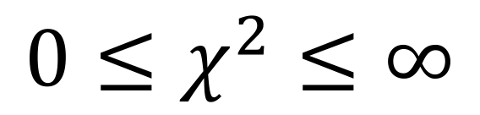
The Chi-squared test – testing for uniform
$${0≤χ}^{2}≤∞$$

Slide 17
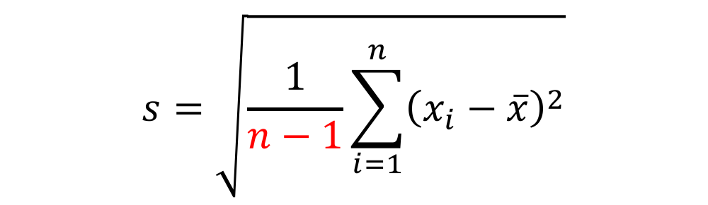

Degrees of freedom
Sample standard deviation
Pearson correlation coefficient
$$s=\sqrt{\frac{1}{n−1}\sum_{i=1}^{n}{{\left(x_{i}−\overline{x}\right)}^{2}}}$$
$$r=\frac{\sum_{i=1}^{n}{(Z_{xi}×Z_{yi})}}{n−1}$$
t-distribution parameter
F-distribution parameters
$$d_{1}=N_{replicates}−1$$
$$v=n−1$$
$$d_{2}=N_{treatments}−1$$

Slide 18
Degrees of freedom

Slide 19
Degrees of freedom
Person 1: Choice
Person 2: Choice
Person 3: Choice
Person 4: Choice
Person 5: Choice
Person 6: Choice
Person 7: No choice

Slide 20
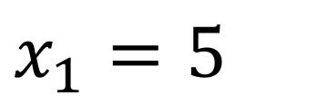
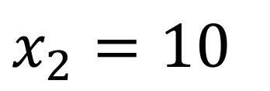
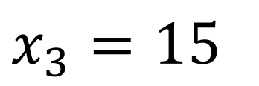
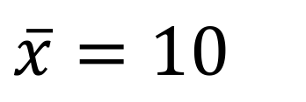
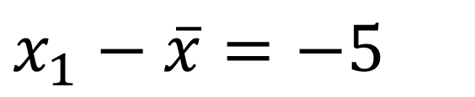
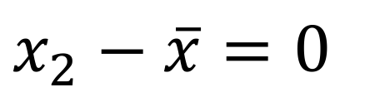
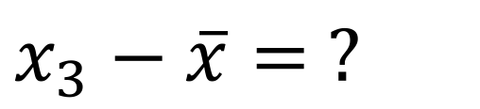
Degrees of freedom
$$x_{1}=5$$
$$x_{1}−\overline{x}=−5$$
$$x_{2}=10$$
$$\overline{x}=10$$
$$x_{2}−\overline{x}=0$$
$$x_{3}=15$$
$$x_{3}−\overline{x}= ?$$

Slide 21
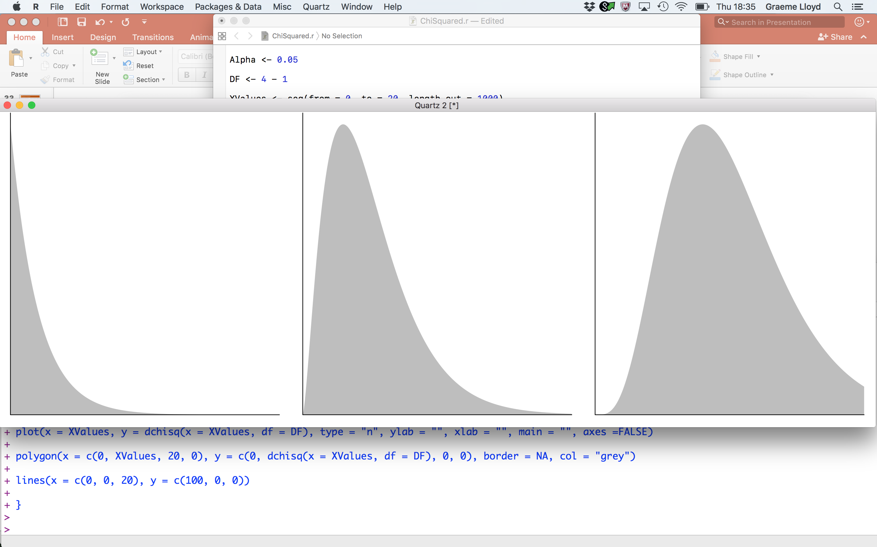
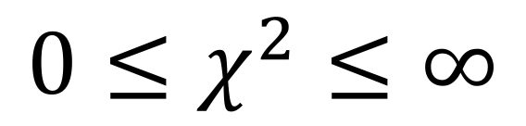
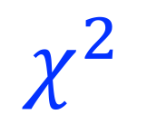
Degrees of freedom
$${0≤χ}^{2}≤∞$$
df = 3 - 1
df = 6 - 1
df = 11 - 1
0
20
0
$$χ^{2}$$
20
0
20

Slide 22
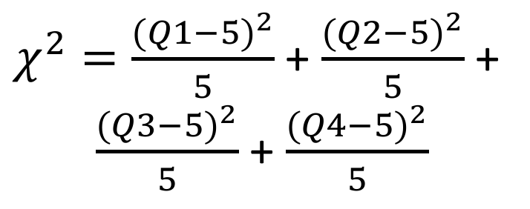
Exercise – part III
$χ^{2}=\frac{{(Q1−5)}^{2}}{5}$ + $\frac{{(Q2−5)}^{2}}{5}$ +
$\frac{{(Q3−5)}^{2}}{5}$ + $\frac{{(Q4−5)}^{2}}{5}$
Q1
Q2
Q3
Q4
df = ?

Slide 23
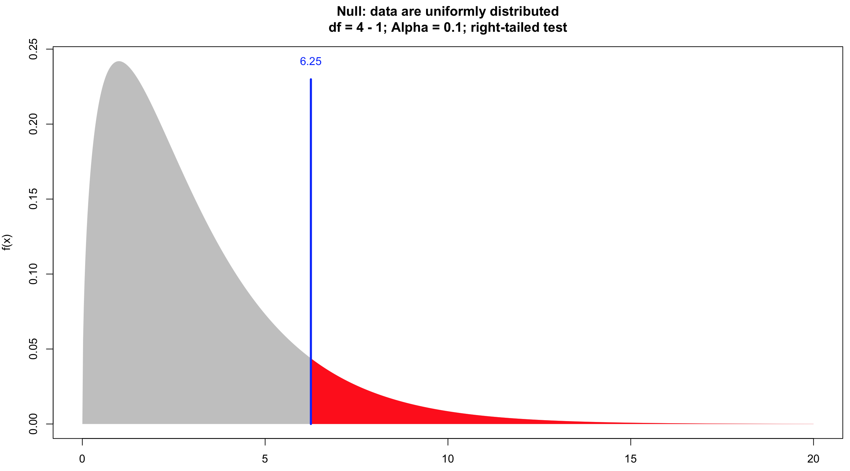
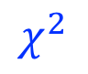
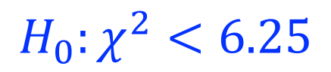

Exercise – part III
$${H_{0}:χ}^{2}<6.25$$
$${H_{1}:χ}^{2}>6.25$$
$$χ^{2}$$

Slide 24
Exercise – part III
Regular
Uniform
Random
Clustered

Slide 25

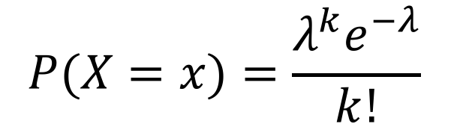
Poisson distribution – testing for random
Discrete probability distribution
$$P(X=x)=\frac{λ^{k}e^{−λ}}{k!}$$
Has single parameter ($λ$), the mean
Expresses probability of given number of events
Assumes randomness; events can occur in space or time
Good null for random distribution of points in space
I.e., in ammonite example expected N quadrants with k ammonites

Slide 26
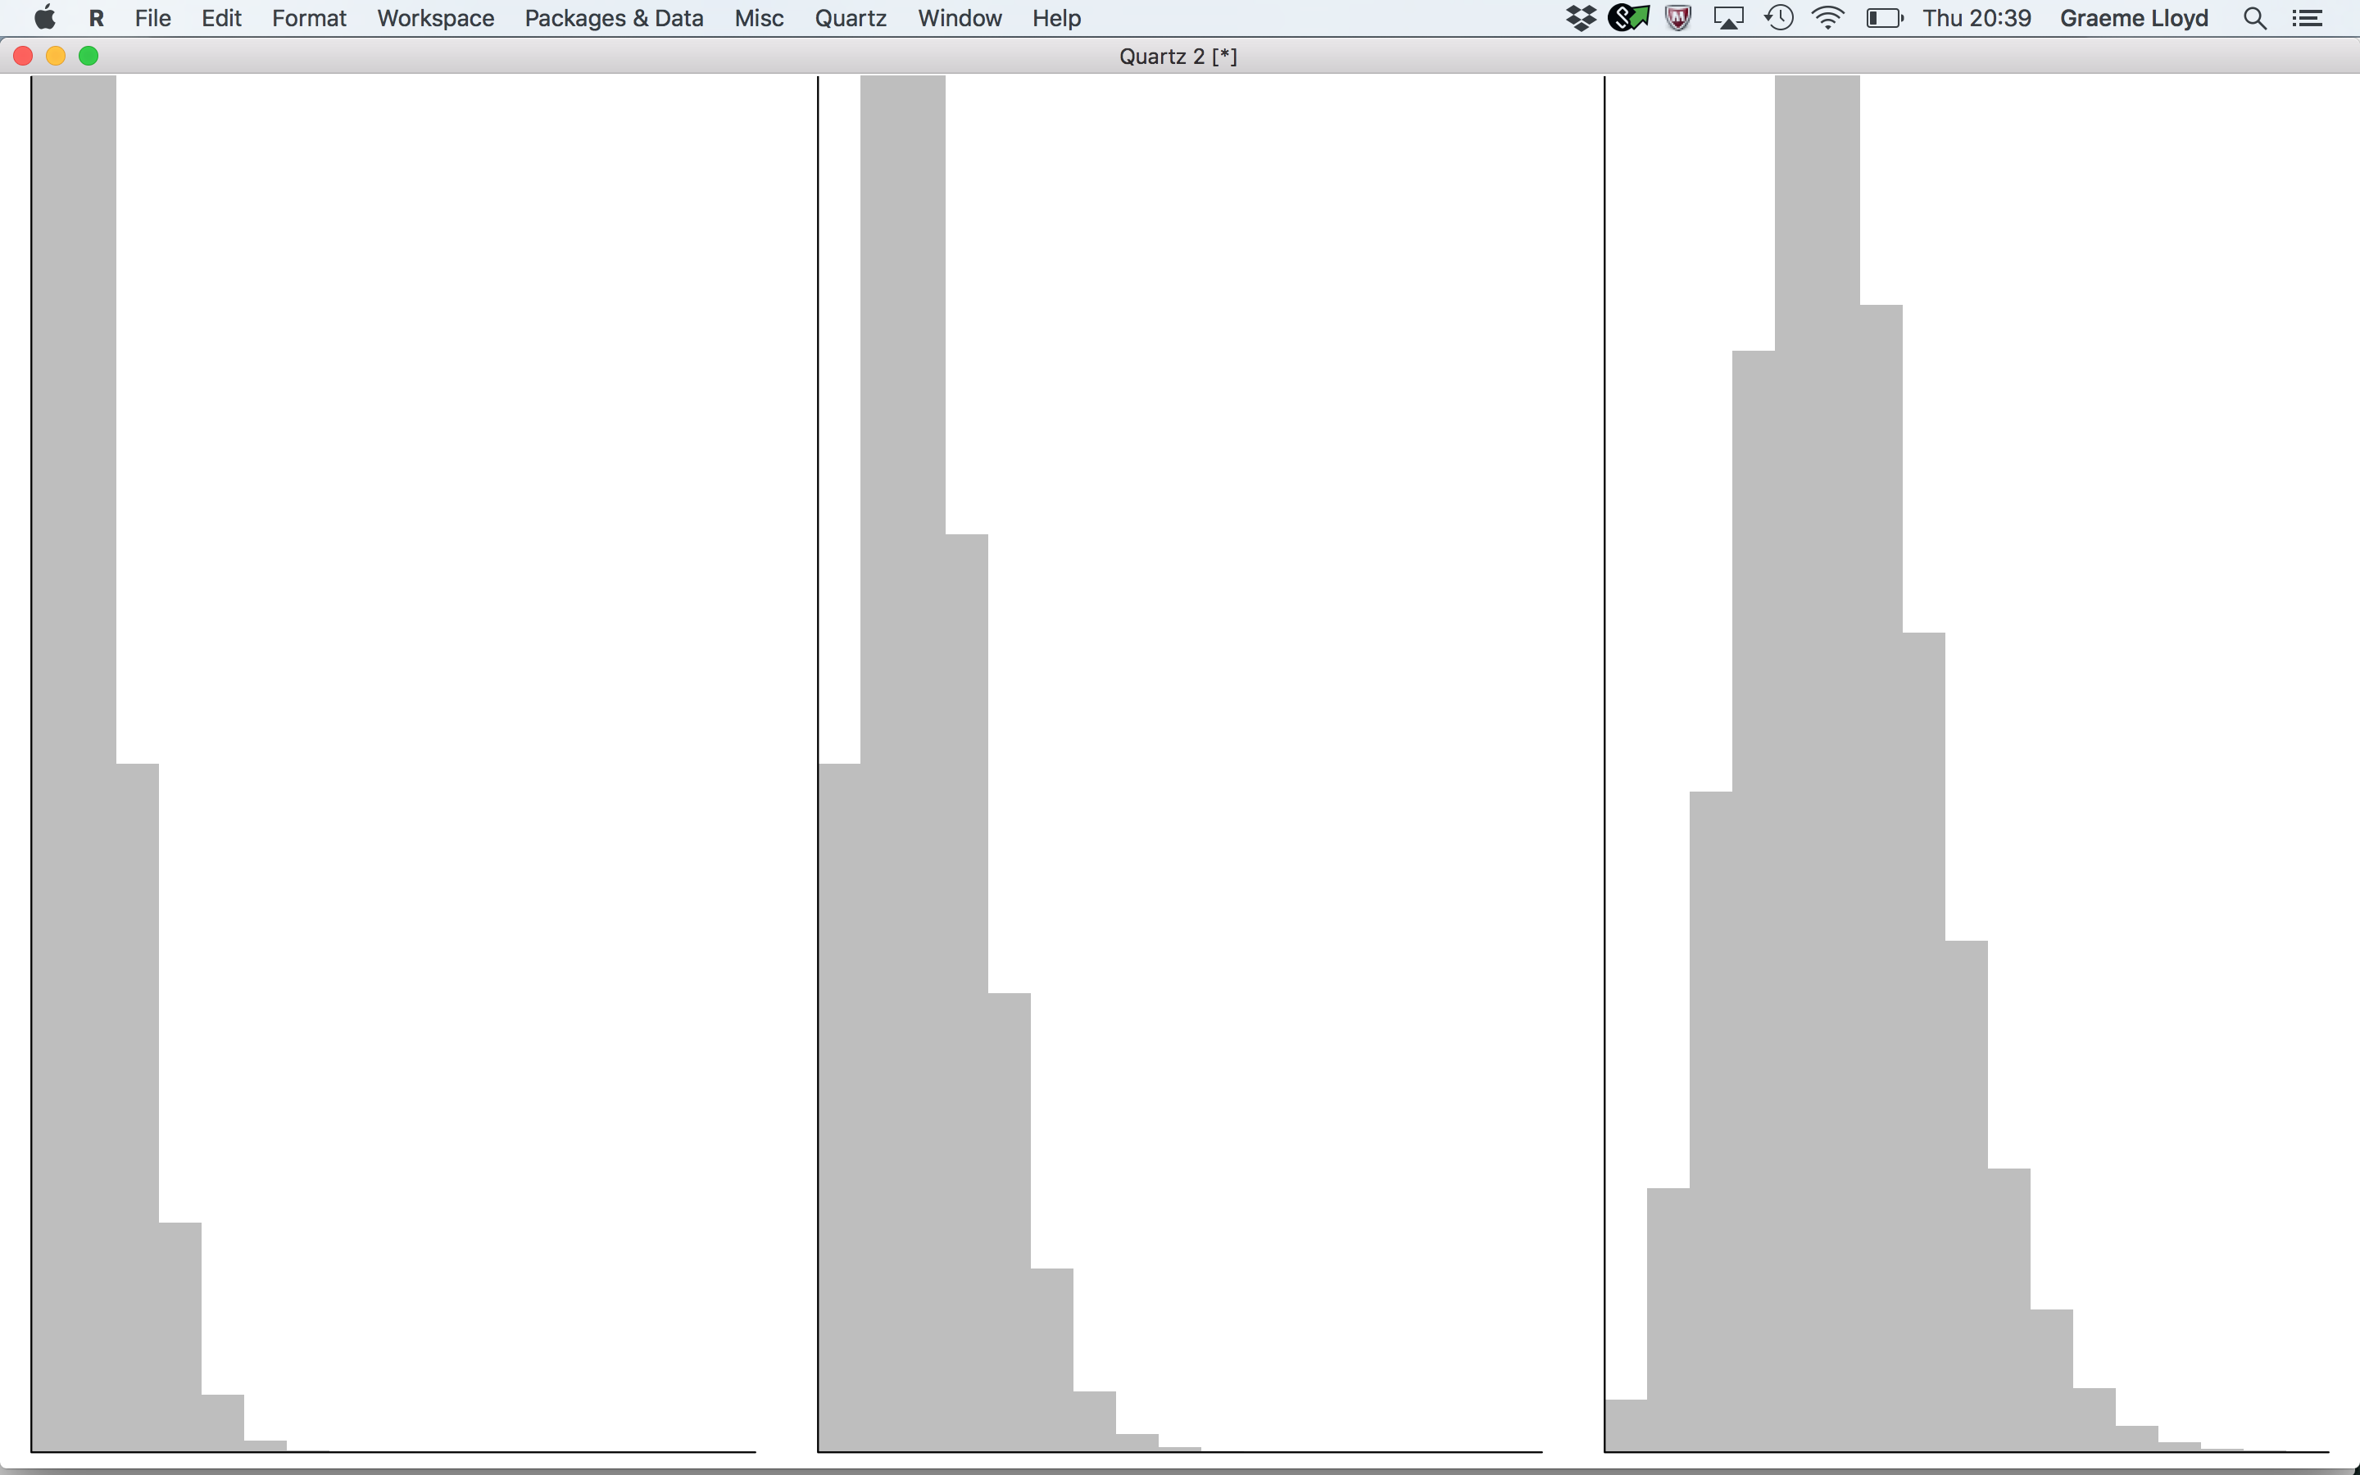




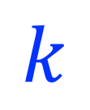
Poisson distribution – testing for random
$$0<λ≤∞$$
$λ$ = 1
$λ$= 2
$λ$ = 5
0
16
0
$$k$$
16
0
16

Slide 27
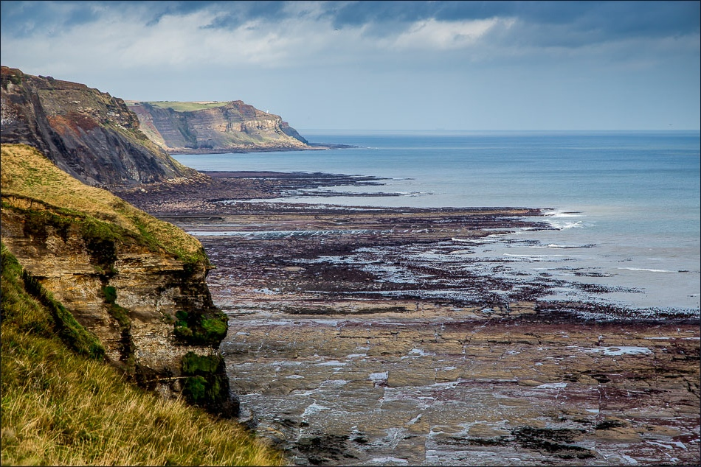
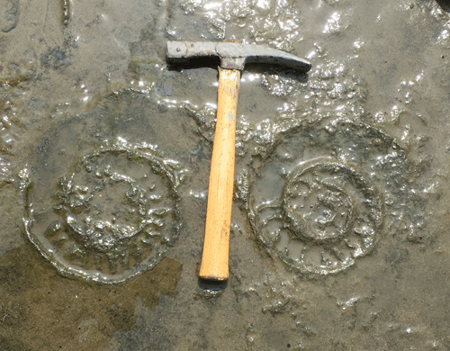
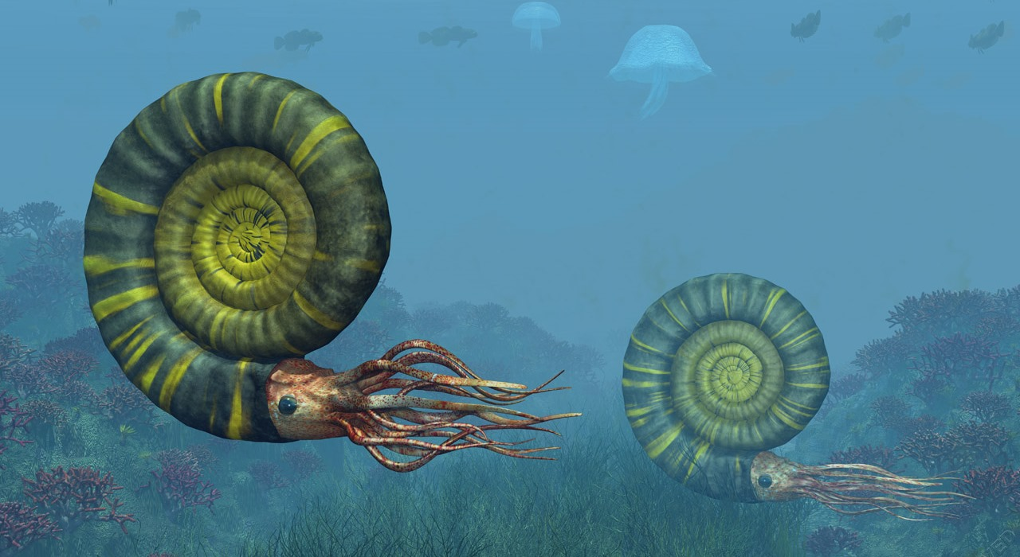
Poisson distribution – testing for random
1
2
3
4
5
6
7
8
9
10
A
B
C
D
E
10m
F
G
H
I
J
10m

Slide 28
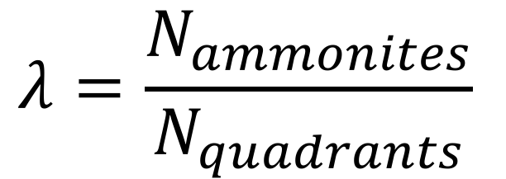
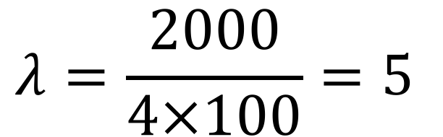
Poisson distribution – testing for random
$$λ=\frac{N_{ammonites}}{N_{quadrants}}$$
$$λ=\frac{2000}{4×100}=5$$

Slide 29
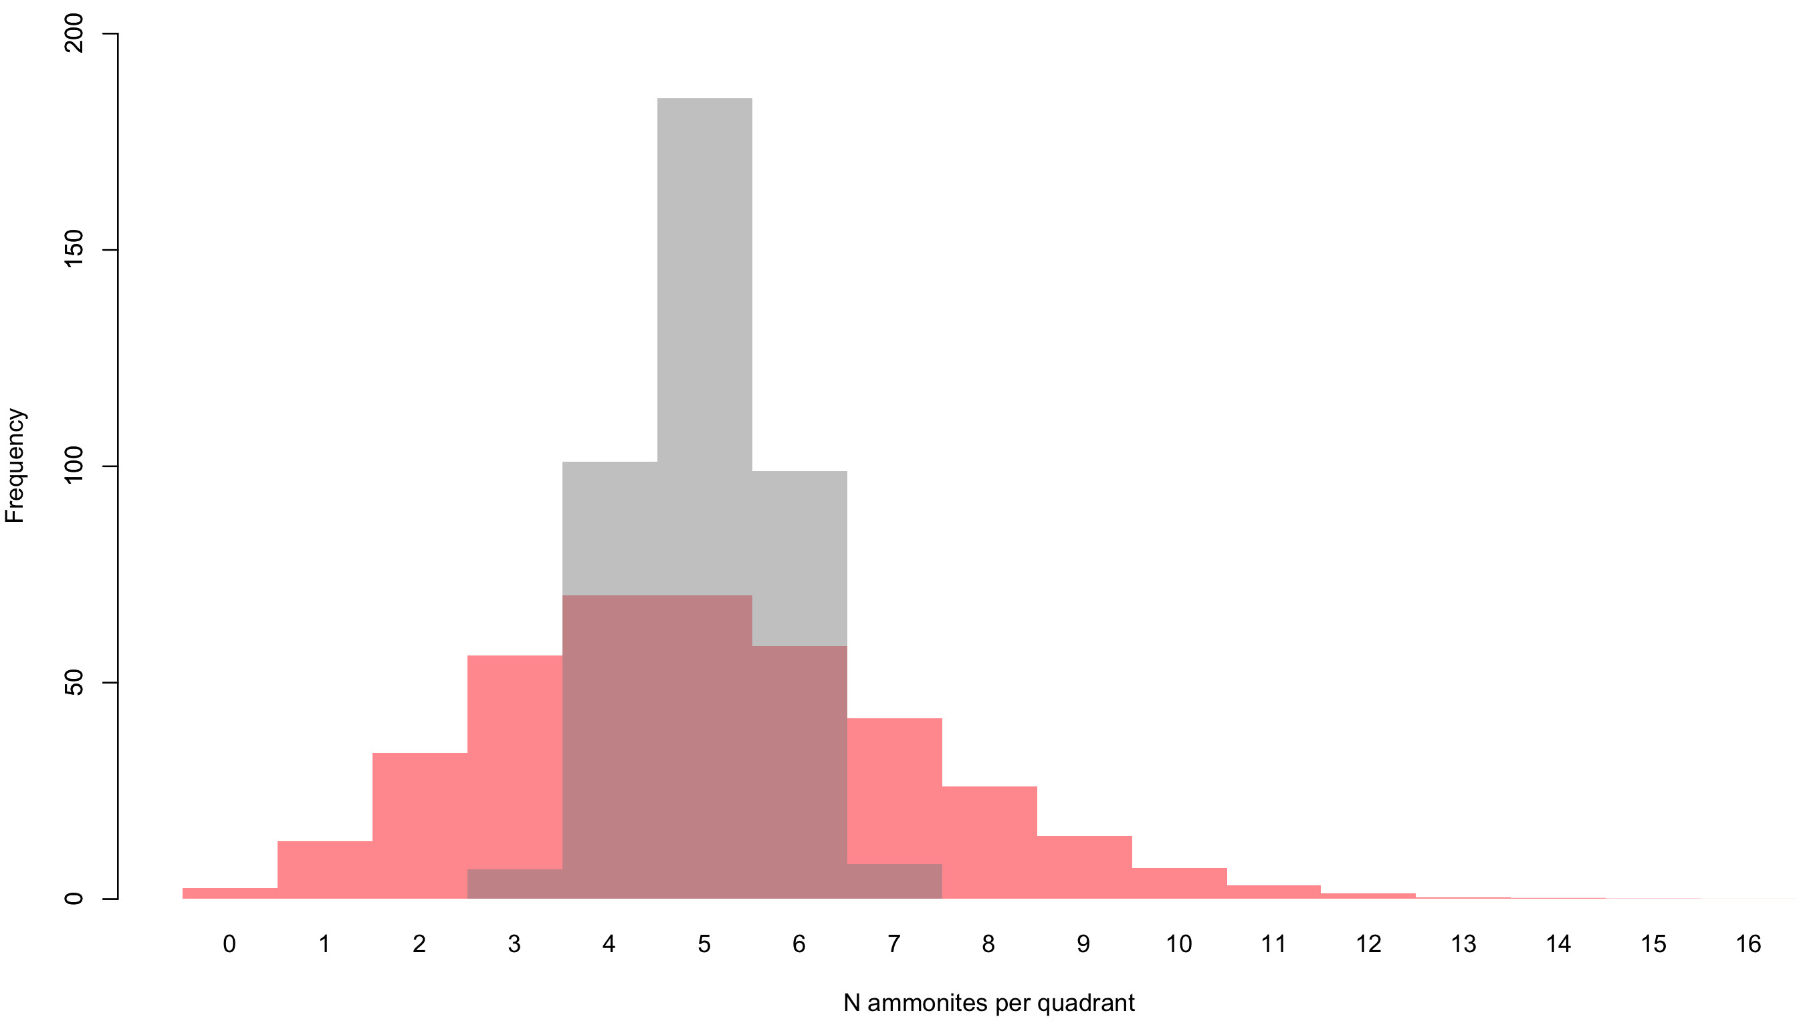
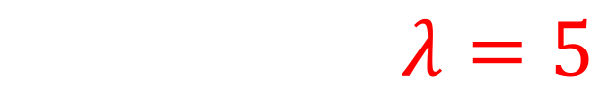
Poisson distribution – testing for random
$$λ=5$$
O_{j}
E_{j}

Slide 30
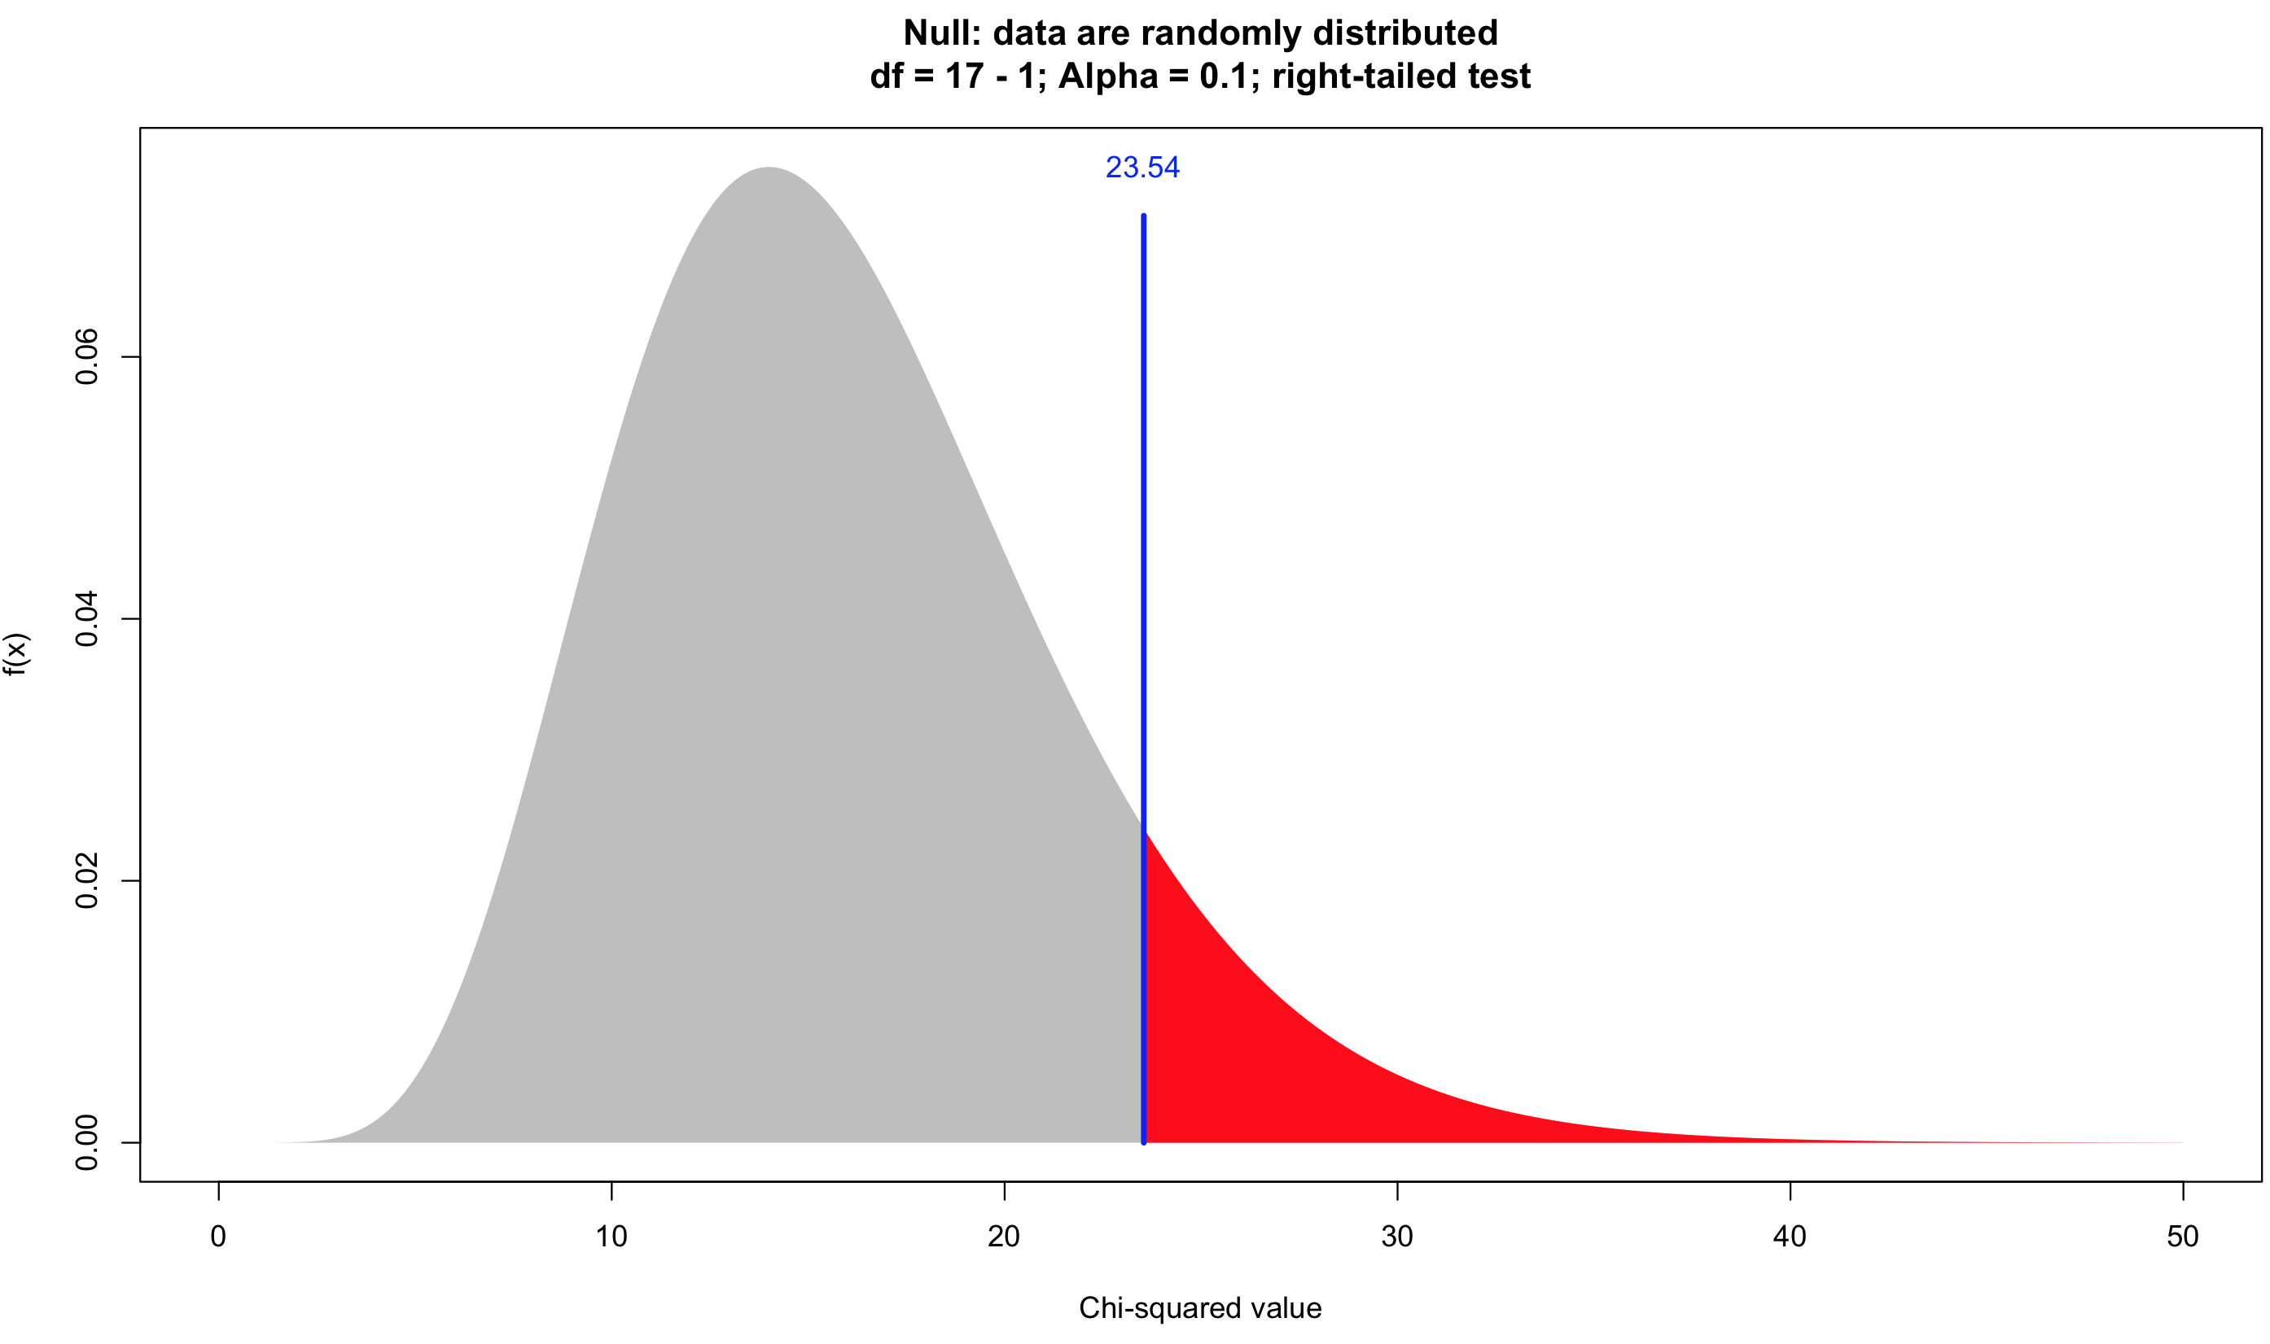
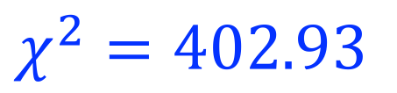


Poisson distribution – testing for random
$${H_{0}:χ}^{2}<23.54$$
$${H_{1}:χ}^{2}>23.54$$
$$χ^{2}=402.93$$

Slide 31
Other tests - nearest neighbour

Slide 32
Other tests - nearest neighbour

Slide 33
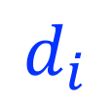
Other tests - nearest neighbour
$$d_{i}$$

Slide 34
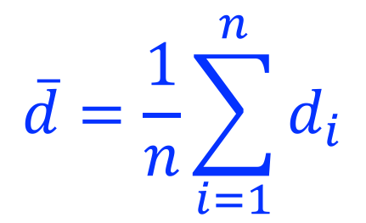
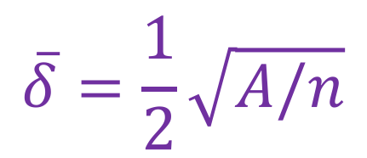
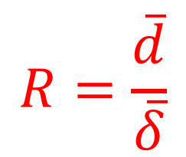
Other tests - nearest neighbour
Mean nearest neighbour distance
$$\overline{d}=\frac{1}{n}\sum_{i=1}^{n}{d_{i}}$$
Captures average distance to nearest point
Expected mean nearest neighbour distance
$$\overline{δ}=\frac{1}{2}\sqrt{A/n}$$
Uses total area (A) and number of objects (n)
Nearest neighbour statistic
$$R=\frac{\overline{d}}{\overline{δ}}$$
Varies from 0 to 2.15

Slide 35
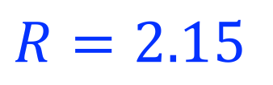
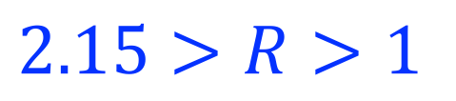
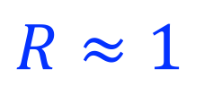
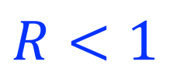
Other tests - nearest neighbour
Nearest neighbour statistic
Regular
Uniform
Random
Clustered
$$R=2.15$$
$$2.15>R>1$$
$$R≈1$$
$$R<1$$

Slide 36

3D regression
y
z
y
x
x

Slide 37

3D regression
Planes
$$z=ax+by+c$$
3D equivalent of straight line
Domes/bowls
$$z=ax+by+{cx}^{2}+{dy}^{2}+exy+f$$
3D equivalent of (simple) curvilinear
More complex
$$z=ax+by+{cx}^{2}+{dy}^{2}+{ex}^{3}…$$
Capture more complex landscapes

Slide 38

The dangers of extrapolation
Source: xkcd

